Slide 1
Terms of Use
This resource is intended for training purposes only. It is provided on an "as-is" basis and is not intended to constitute legal, migration or other professional advice. Users should not rely on this resource as a substitute for obtaining independent advice or conducting their own research. Where updates or revisions are issued, only the most current version should be used to ensure the information remains accurate and up to date.

Slide 2
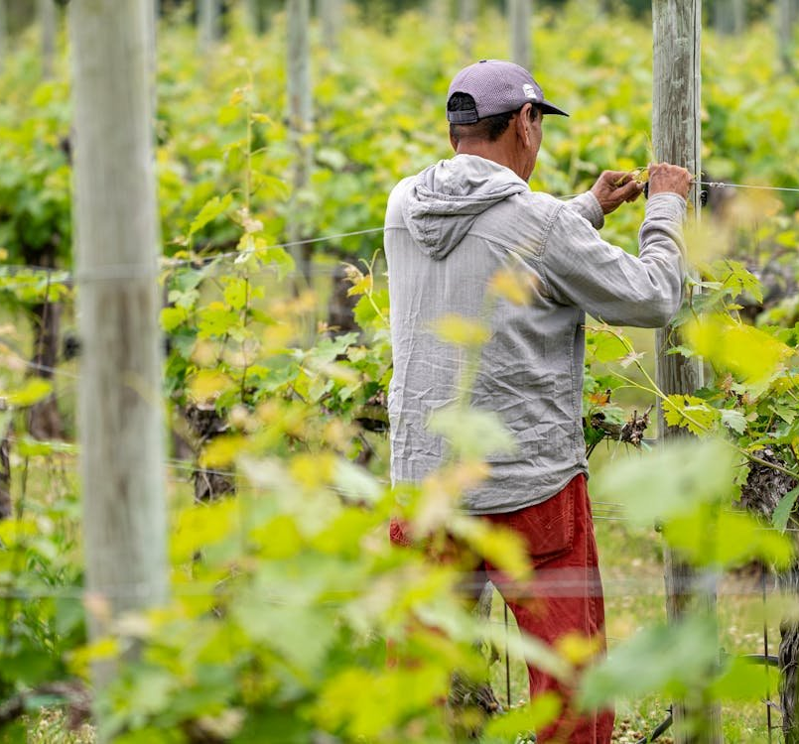
15-Minutes Train the Trainer for Workers
Understanding modern slavery & exploitation at work in Australia. And how to get Help.
Notes:
Internal comment:
The aim of this presentation is to equip Work Right Hub ambassadors with a clear, practical, and easy-to-use presentation that enables them to confidently deliver consistent, safe, and culturally relevant training to workers in their communities.

Slide 4
Today you will learn:
Fair and Safe Work
About Exploitation at Work & Modern Slavery
About the Work Right Hub
Organisations that offer help
01
02
03
04

Slide 5
Everyone has the right to Fair and Safe Work in Australia regardless of their visa status ​
​
Fair Work
A Safe Workplace
Superannuation​
Payslips showing what you earned and any deductions​
Leave Entitlements
Protection from Exploitation & Forced Labour​
Freedom from Discrimination​
Protection from Bullying & Harassment​
Workers' Compensation​
Right to Ask for Help & Make Complaints

Slide 6
What is the difference between Exploitation at Work and Modern Slavery?

Slide 7

Exploitation at Work = A worker's rights are not respected
Exploitation at work happens when an employer treats workers unfairly and breaks workplace laws. Workers still have some freedom, as they can usually leave their job, move around, and keep their documents, but their rights are not respected.
Modern Slavery = A worker's freedom is taken away
Modern slavery happens when a person is forced to work because someone uses threats, pressure, lies, or tricks to control them. The person cannot move freely, cannot make their own choices, and loses their dignity and independence.

Slide 8
As conditions get more severe — more threats, more control, less freedom — the situation moves closer to modern slavery.
Fair Work
Poor Work Conditions
Workplace Exploitation
Modern Slavery

Slide 9
Common Signs of Work Exploitation
People still have some freedom — they can leave the job, move around, and keep their documents, but their rights are being violated.
Being underpaid or having wages taken away
Being asked to work too many hours
Unsafe or unhealthy work conditions
Unfair deductions, discrimination, or bullying

Slide 10
Common Signs of Modern Savery
Modern slavery is when a person is forced to work and cannot freely leave because of threats, control, or deception.
Having their passport taken
Being afraid to leave because of threats or punishment
Very little or no pay
Unfair deductions to their pay, discrimination, or bullying
Someone controlling where they work, live, or go
Debt they can “never pay off”

Slide 11
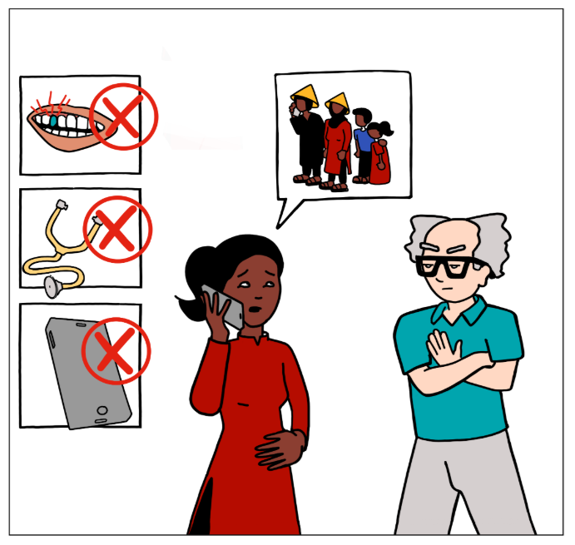
"I am worried about reaching out"
It is normal to feel unsure or worried about reaching out for help, especially if someone has been told that nobody will help them or that they will be in trouble if they ask for help.

Slide 12
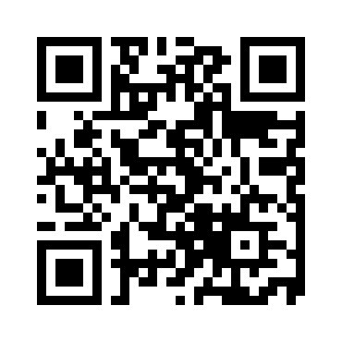
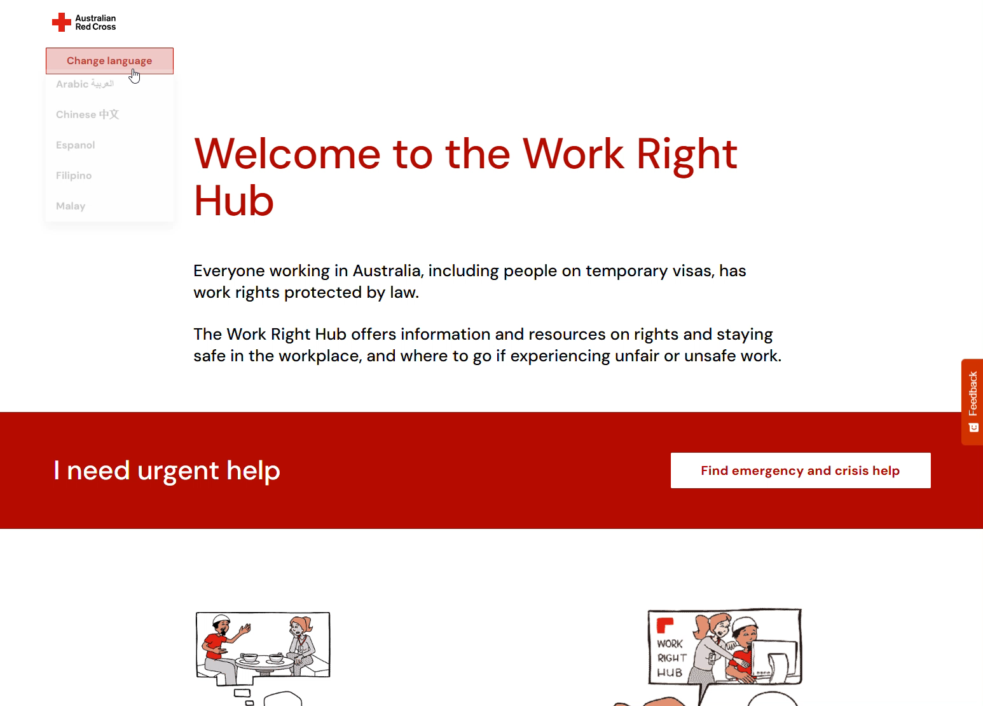
Work Right Hub
www.redcross.org.au/workrighthub
The Work Right Hub is an online platform that offers free information and resources on rights and how to stay safe in the workplace, and where to go if experiencing unfair or unsafe work.

Slide 13
Work Right Hub has been designed to be easy to navigate and includes a range of support mechanisms to help individuals find material, information, or reporting avenues specific to their needs.
Emergencies and crisis response
Situational self-assessment
Information on rights
Training and online courses
Support Service Directory
Modern slavery resources​

Slide 14
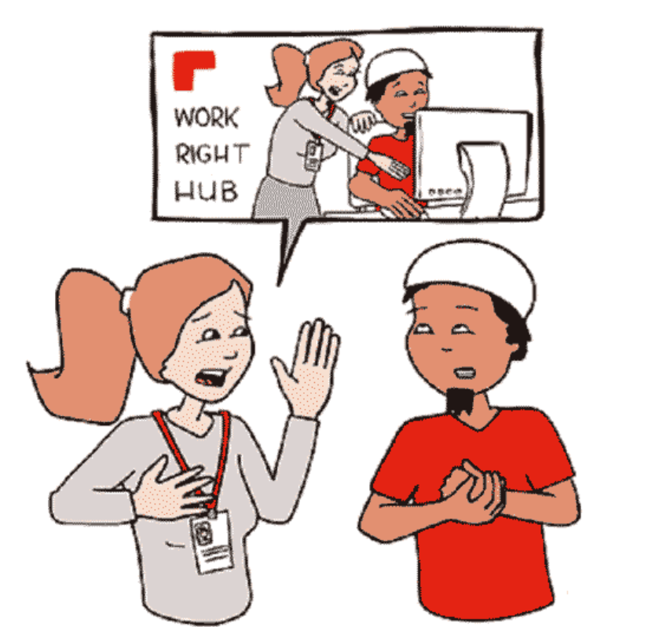
You can get help
Safely
Anyone can ask for help, no matter what visa they have — even if they do not have a valid visa. Many organisations offer free and confidential support.

Slide 15
Emergency Support | Call 000
Fair Work Ombudsman | 13 13 94
Australian Federal Police (AFP) | 131 237 (131 AFP)
Additional Referral Pathway (ARP) | 1800 000 277
Anti-Slavery Australia | 02 9514 8115
Support for Trafficked People Program (Australian Red Cross) | 1800 113 015
Office of the NSW Anti-slavery Commissioner | 1800 FREEDOM - 1800 373 3366

Slide 16

Making referrals to appropriate service providers is a key step in connecting individuals with relevant assistance. ​
It is vital that this process is voluntary and shaped by the person, to promote strengths-based approaches and informed consent.
Notes:
This step is important, but it must always be voluntary. The person must understand the referral and agree to it before you contact another service.
Good practice includes:
Explaining what the services do and how referrals work
Getting and recording clear consent
Referring to services that meet the person’s immediate and long‑term needs
Choosing trusted and professional services
Checking eligibility before making a referral
Following up to see how the person is going
Keeping referral information safe, confidential, and secure
This helps ensure the person gets the right support in a respectful way.

Slide 17
Support for Trafficked People Program (STPP)

Slide 18

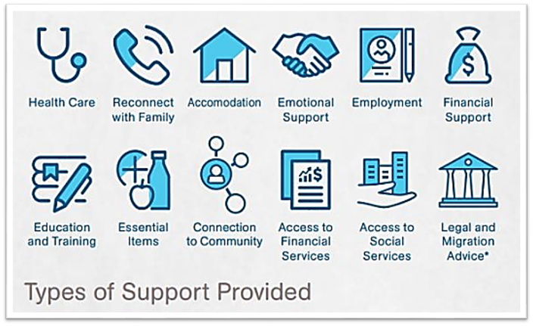
Support for Trafficked People Program
The program aims to help people who have experienced human trafficking, slavery, or slavery-like practices in meeting their immediate safety, security, health, and wellbeing needs, and to develop options for life after they leave the STPP.

Slide 19
Who can access the STPP
Anyone in Australia can access STPP if:
they have experienced any type of modern slavery (including forced marriage if other types of modern slavery related exploitation are present*); and
they have been identified as eligible by the Australian Federal Police or the Additional Referral Pathway
There are two different ways to access the STPP:
1. Through a referral from the Australian Federal Police (AFP) - You can contact the AFP on 131 AFP (131 237) and report your situation of exploitation.
2. Through the Additional Referral Pathway (ARP), led by The Salvation Army - You can contact The Salvation Army on 1800 000 277 or visit The Salvation Army.

Slide 20

When someone is referred to the STPP by the Australian Federal Police or the Additional Referral Pathway, the Australian Red Cross supports them closely to help them in meeting their safety, security, health, and wellbeing needs. It can include finding a safe place to stay, helping with medical care, housing, legal or migration help, education or work, and giving emotional support.
People usually receive support for at least 90 days, plus up to 20 workdays to help them get ready to leave the program.
Support may last longer if needed. You can contact us for confidential advice if you are worried about yourself or someone you know who may be experiencing modern slavery.
Or national_stpp@redcross.org.au

Slide 21
Thank you
Explore the Work Right Hub for yourself
redcross.org.au/workrighthub

