Slide 1
Work Right Hub Asset Toolkit

Slide 3
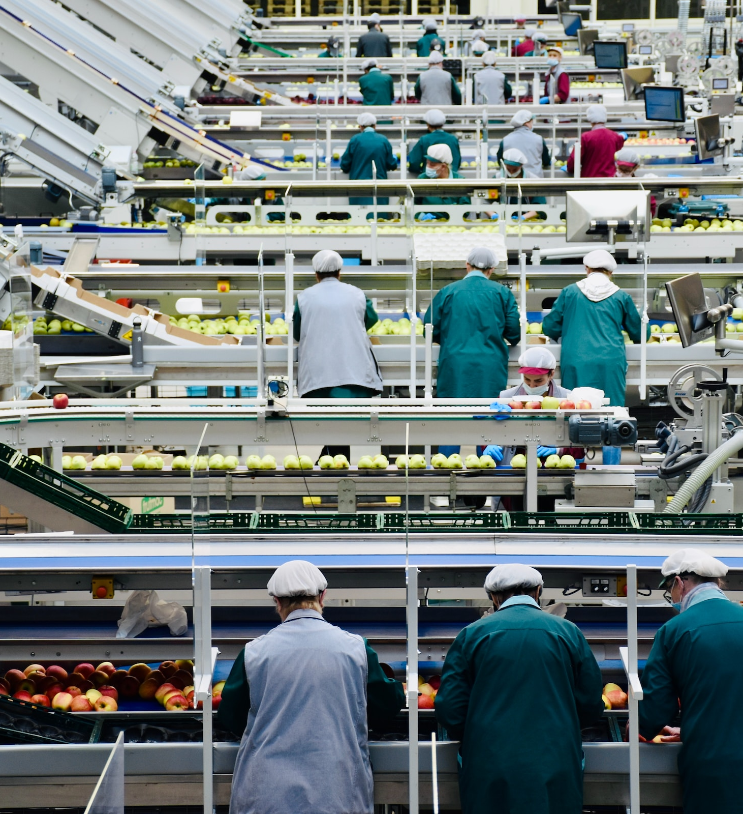
Work Right Hub Asset Toolkit
This Toolkit is a suite of assets and templates to support in promoting the Australian Red Cross Work Right Hub across your channels.
It includes:
Newsletter and Email templated copy
Email footers
Posters
Flyers
Digital checklist
Presentation slides
Organic social assets
Note: The Work Right Hub received funding from the Australian Government Modern Slavery Grants Program.

Slide 4


Modern Slavery – Exploitation At Work Video

Slide 5

Modern Slavery – Exploitation At Work Video

Slide 6

Newsletter and Email Features

Slide 7

Newsletter Feature – Templated Copy
The Work Right Hub: Empowering Migrant Workers to Know Their Rights
Everyone working in Australia, including people on temporary visas, has work rights protected by law. Yet many workers are unaware of these rights or where to seek advice and support.
Exploitation can happen in any job and affect anyone. Recognising the signs and knowing what steps to take is essential if you or someone you know is vulnerable in the workplace.
The Work Right Hub, developed by Australian Red Cross in consultation with migrant workers, provides clear information on workplace rights and issues such as exploitation and modern slavery.
This online tool offers practical resources, including how to access confidential advice and support anywhere in Australia, plus tailored guidance across different industries. It also includes Train-the-Trainer materials and free e-learning modules, designed to help organisations and community leaders deliver sessions on workplace rights and responding to exploitation.
To learn more about the Work Right Hub or arrange an information session for your team or community group, contact Ina Vergara, Project Lead – Work Right Hub at ivergara@redcross.org.au.
The Work Right Hub is proudly supported by the Commonwealth Government’s Modern Slavery Grant Program.

Slide 8

Email Introduction
Subject: Discover the Work Right Hub – Supporting Safe and Fair Work
Dear <NAME>,
We would like to share a valuable resource with you: the Work Right Hub, a website developed by Australian Red Cross to help migrant workers understand their rights at work and know where to go for advice or support.
Everyone working in Australia, including people on temporary visas, has work rights protected by law. Unfortunately, not all workers are aware of these rights or how to seek help when needed.
The Work Right Hub provides clear information on workplace rights, how to recognise signs of exploitation, and where to access confidential advice and support services across Australia. It also includes practical tools such as checklists, translated resources, and free online training modules.
👉 Explore the Work Right Hub: redcross.org.au/workrighthub
Please share this resource with your networks and communities, it could make a real difference for someone who needs support.
Sincerely, <NAME>
The Work Right Hub is funded by the Australian Government Modern Slavery Grants Program.

Slide 9
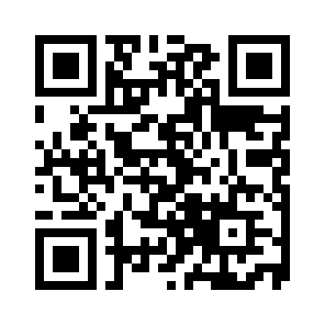
Work Right Hub QR Code
How partners can use this QR code:
Print and display it in offices, community spaces, or events.
Include it in newsletters, flyers, or posters to make access easy.
Share digitally in emails, social media posts, or WhatsApp groups.
Use it during information sessions or training so participants can quickly visit the Hub.
This QR code is designed to help you connect workers and communities to reliable information and support. Please feel free to use and share widely.

Slide 10

Email Footer

Slide 11


Email Footer

Slide 12

Download Posters, Flyers, and Digital Checklist

Slide 13
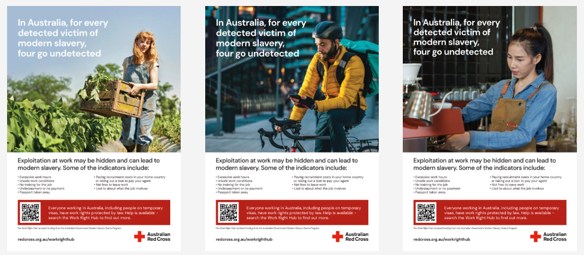
Modern Slavery Resources
Downloadable materials, videos, guides, and toolkits about modern slavery in Australia.
A flyer, postcard, brochure, smaller discreet brochure, poster and digital checklist are available in 11 different languages to download: Work Right Hub: Downloadable materials
Videos: Work Right Hub: Videos
Guides and toolkits: Work Right Hub: Guides and toolkits

Slide 14

Presentation Slide

Slide 15


Work Right Hub
The Work Right Hub is a website developed by Australian Red Cross, in consultation with migrant workers, to offer information on work rights and issues such as labour exploitation and modern slavery.
The website includes useful information such as how to access confidential advice or support from anywhere in Australia, as well as where to find specific advice and guidance across a range of industry sectors.
For Workers
Information about work rights in Australia, exploitation and modern slavery
Advice on how to identify signs of exploitation and seek support
Contact list of support services via the National Services Directory
For Frontline Responders
Information about identifying exploitation and how to safely respond
Referral to support networks via the National Services Directory
Modern slavery training and resources
redcross.org.au/workrighthub
The Work Right Hub received funding from the Australian Government Modern Slavery Grants Program.

Slide 16

Organic Social Tiles

Slide 17

Social Tile: General
In Australia, everyone has rights at work - no matter your citizenship or visa status.
Visit the Australian Red Cross Work Right Hub to: ✅ Learn what safe and fair work looks like ✅ Understand your rights and how to protect them ✅ Recognise the signs of unfair treatment, unsafe conditions or modern slavery ✅ Find out what steps to take if you or someone you know needs support.
Call to action
Your safety and dignity at work matters Work Right Hub | Australian Red Cross
The Work Right Hub received funding from the Australian Government Modern Slavery Grants Program.

Slide 18

Social Tile: Cleaner
In Australia, everyone has rights at work - no matter your citizenship or visa status. The cleaning industry is no exception.
Visit the Australian Red Cross Work Right Hub to: ✅ Learn what safe and fair work looks like ✅ Understand your rights and how to protect them ✅ Recognise the signs of unfair treatment, unsafe conditions or modern slavery ✅ Find out what steps to take if you or someone you know needs support.
Call to action
Your safety and dignity at work matters Work Right Hub | Australian Red Cross
The Work Right Hub received funding from the Australian Government Modern Slavery Grants Program.

Slide 19
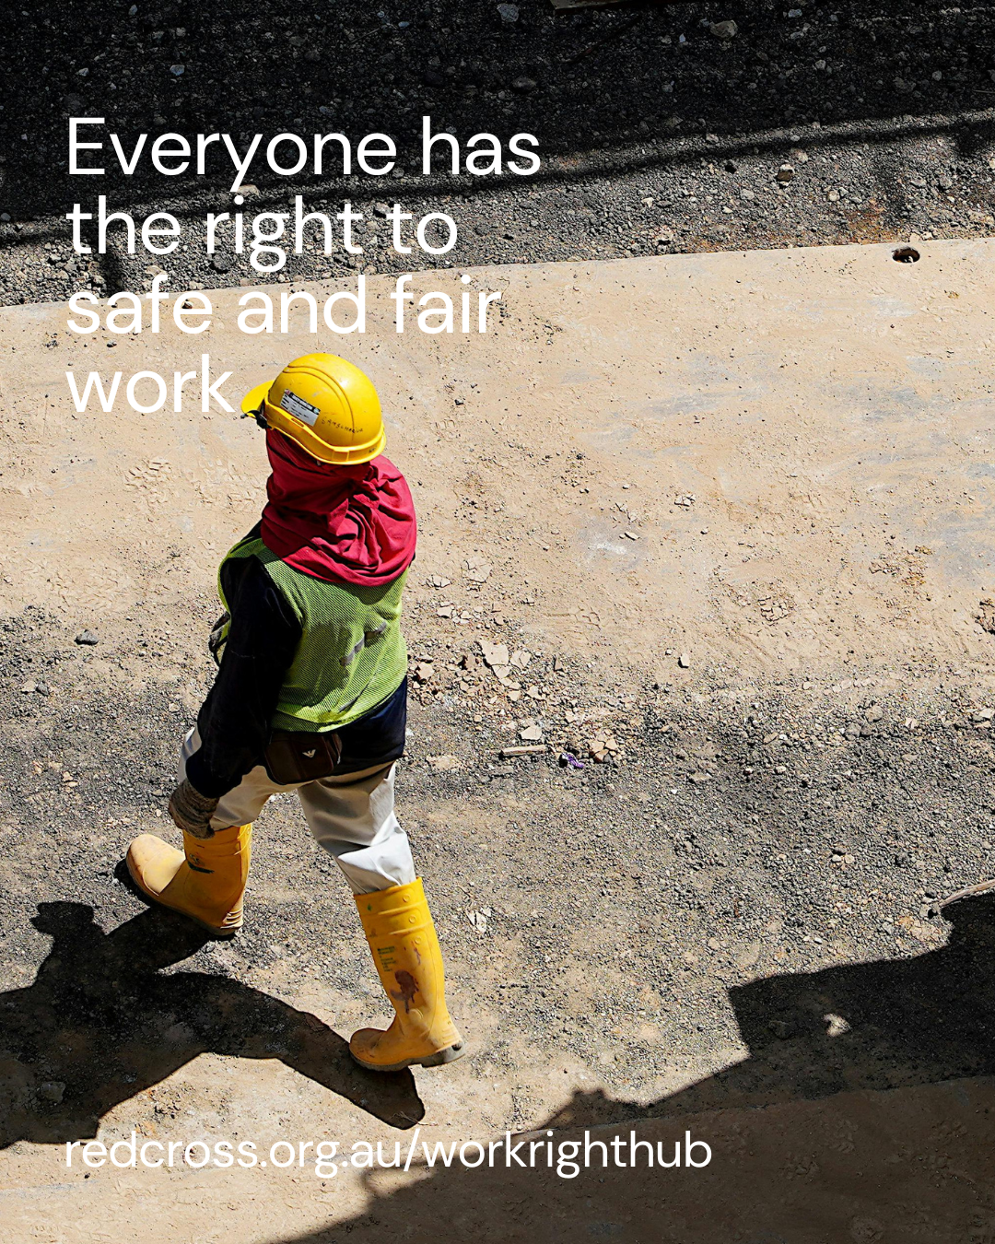
Social Tile: Construction
In Australia, everyone has rights at work - no matter your citizenship or visa status. The construction industry is no exception.
Visit the Australian Red Cross Work Right Hub to: ✅ Learn what safe and fair work looks like ✅ Understand your rights and how to protect them ✅ Recognise the signs of unfair treatment, unsafe conditions or modern slavery ✅ Find out what steps to take if you or someone you know needs support.
Call to action
Your safety and dignity at work matters Work Right Hub | Australian Red Cross
The Work Right Hub received funding from the Australian Government Modern Slavery Grants Program.

Slide 20

Social Tile: Gig Worker
In Australia, everyone has rights at work - no matter your citizenship or visa status. The gig economy is no exception.
Visit the Australian Red Cross Work Right Hub to: ✅ Learn what safe and fair work looks like ✅ Understand your rights and how to protect them ✅ Recognise the signs of unfair treatment, unsafe conditions or modern slavery ✅ Find out what steps to take if you or someone you know needs support.
Call to action
Your safety and dignity at work matters Work Right Hub | Australian Red Cross
The Work Right Hub received funding from the Australian Government Modern Slavery Grants Program.

Slide 21
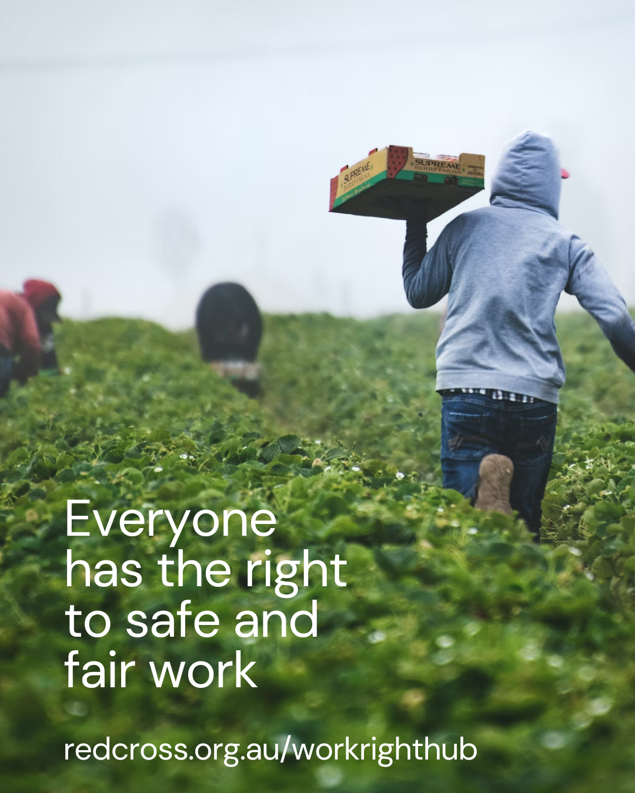
Social Tile: Horticulture
In Australia, everyone has rights at work - no matter your citizenship or visa status. The horticulture industry is no exception.
Visit the Australian Red Cross Work Right Hub to: ✅ Learn what safe and fair work looks like ✅ Understand your rights and how to protect them ✅ Recognise the signs of unfair treatment, unsafe conditions or modern slavery ✅ Find out what steps to take if you or someone you know needs support.
Call to action
Your safety and dignity at work matters Work Right Hub | Australian Red Cross
The Work Right Hub received funding from the Australian Government Modern Slavery Grants Program.

Slide 22

Social Tile: Hospitality
In Australia, everyone has rights at work - no matter your citizenship or visa status. The hospitality industry is no exception.
Visit the Australian Red Cross Work Right Hub to: ✅ Learn what safe and fair work looks like ✅ Understand your rights and how to protect them ✅ Recognise the signs of unfair treatment, unsafe conditions or modern slavery ✅ Find out what steps to take if you or someone you know needs support.
Call to action
Your safety and dignity at work matters Work Right Hub | Australian Red Cross
The Work Right Hub received funding from the Australian Government Modern Slavery Grants Program.

Slide 23

Social Tile: Young worker
In Australia, everyone has rights at work - no matter your age, citizenship, or visa status.
Visit the Australian Red Cross Work Right Hub to: ✅ Learn what safe and fair work looks like ✅ Understand your rights and how to protect them ✅ Recognise the signs of unfair treatment, unsafe conditions or modern slavery ✅ Find out what steps to take if you or someone you know needs support.
Call to action
Your safety and dignity at work matters Work Right Hub | Australian Red Cross
The Work Right Hub received funding from the Australian Government Modern Slavery Grants Program.

Slide 24

Social Tile: International Students
In Australia, everyone has rights at work - no matter your age, citizenship, or visa status.
Visit the Australian Red Cross Work Right Hub to: ✅ Learn what safe and fair work looks like ✅ Understand your rights and how to protect them ✅ Recognise the signs of unfair treatment, unsafe conditions or modern slavery ✅ Find out what steps to take if you or someone you know needs support.
Call to action
Your safety and dignity at work matters Work Right Hub | Australian Red Cross
The Work Right Hub received funding from the Australian Government Modern Slavery Grants Program.

Slide 25
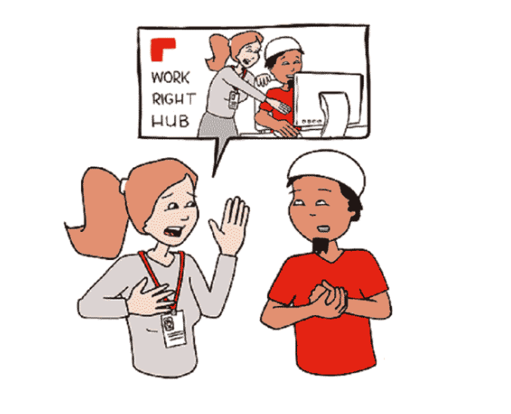
Thank you for partnering with us to protect workplace rights.

