Slide 1
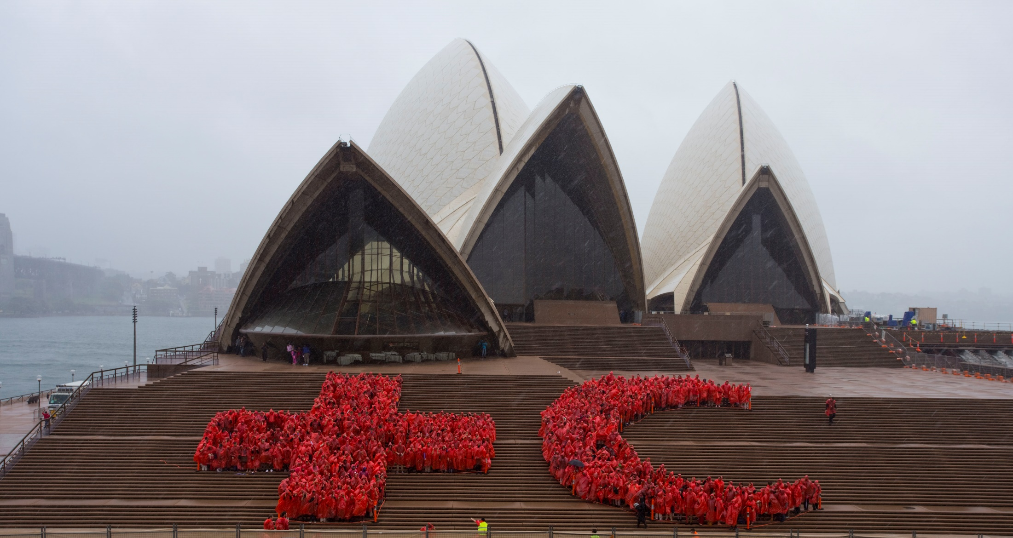
Under the red cross emblem

Slide 2

The protective emblems
Don’t shoot!
In armed conflict, this person, vehicle, site or equipment is providing neutral humanitarian aid.
Protect these emblems as they protect life.
Notes:
The red cross is used in times of armed conflict to say ‘Don’t shoot.’
It indicates that people, materials, buildings and transports displaying the emblem are not part of the fighting but are responsible for providing neutral humanitarian assistance. For this reason they must not be targeted but protected.
Typically the red cross will be worn by the medical personnel of the armed forces and placed on hospitals and ambulances. It is also worn by those working for the Red Cross itself.
Image top right is of the USNS (US Naval Ship) Mercy.
Image bottom right: Red crescent on medical tent in the Middle East. The positioning of the crescent (facing left) is interesting, and unusual, perhaps reflecting Arabic language, written right to left.

Slide 3

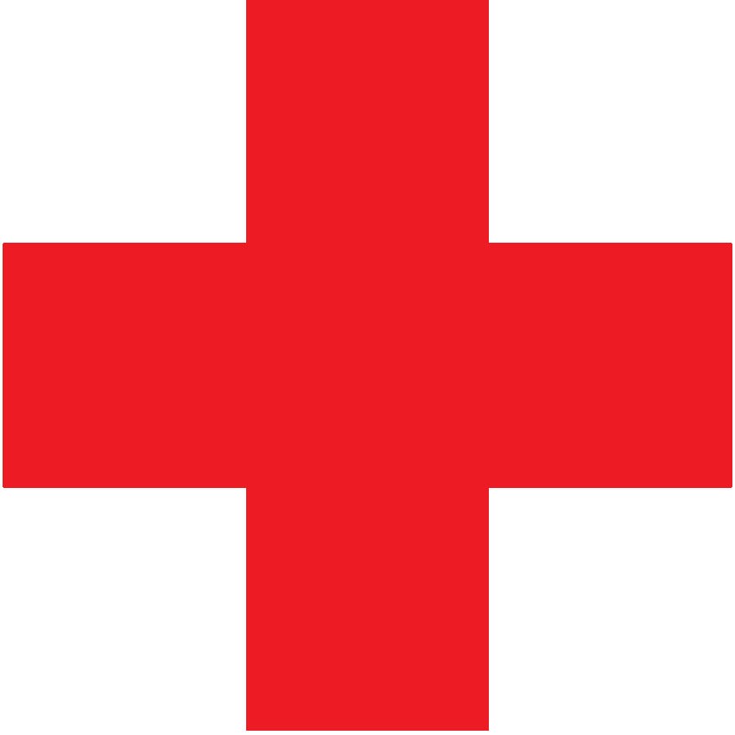
Why the red cross?
Reverse of the Swiss flag
Visibility: clean and clear
Not the shape of a Christian cross
Notes:
In 1864, when the twelve countries which agreed to the First Geneva Convention adopted the red cross into international law, they did not intend any religious significance and had little idea of the controversies that were to follow. The idea was to honour the Swiss founders of the Red Cross organisation.
As the use of the red cross spread from Europe, some – such as the Turks in 1876 – objected to the red cross, seeing it as a Christian symbol.
Even though the red cross was even, in the shape of five equal squares, and not the same as the Christian crucifix, from a Moslem perspective it would always be linked with the medieval Crusades when knights like Richard the Lionheart wore red crosses on their breastplates.

Slide 4

The red crescent
The red cross is often misunderstood as a Christian symbol
The red crescent was used in the field from 1876
Firstly by Turks (Ottoman Empire)
Officially adopted from 1929
Notes:
There are some ugly stories from these early years when medical personnel had their left arms severed to show what was thought of the red cross emblem.
More countries simply began using the red crescent, the red moon shape, instead. The law had to catch up with the reality of what was occurring in the field.
The red crescent was formally accepted as a second symbol, equivalent in legal status to the red cross, at an international conference in 1929.
Australia nominated that its military forces would use the red cross, and obviously we have the Australian Red Cross. Bangladesh and Iraq, for example, chose the red crescent emblem, so their children grow up as familiar with the name Bangladeshi or Iraqi Red Crescent as we are with Australian Red Cross.
All are parts of the same International Red Cross and Red Crescent Movement, represented in nearly 190 nations of the world.

Slide 5
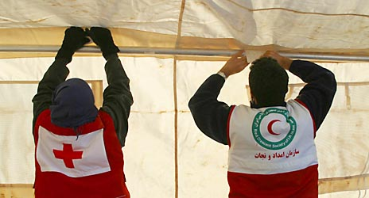
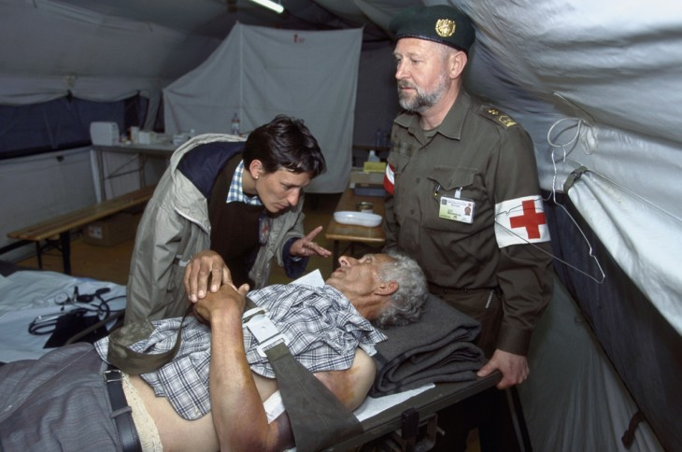
Who can wear the emblems?
Workers of the Red Cross and Red Crescent Movement
Military medical personnel & chaplains
Must be non-combatants
Must give medical care solely on basis of need

Slide 6
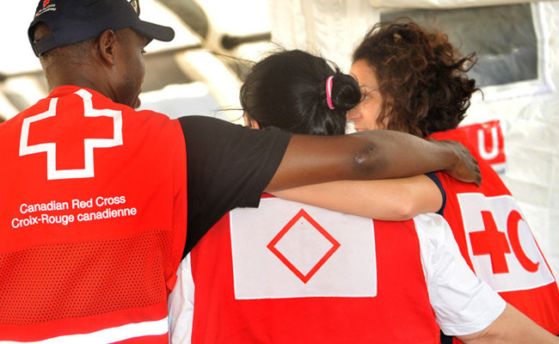
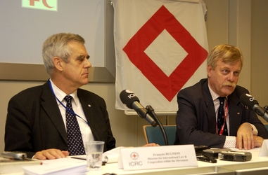
The red crystal
A third emblem for nations not comfortable with either the cross or crescent
Notes:
Some nations were unhappy with either the cross or the crescent.
Israel, for example, insisted on its own use of the red star of David.
What was not wanted was a proliferation of emblems according to nationality - the emblem was meant to over-ride national, ethnic, religious, political connotations.
The red crystal (or diamond shape) was widely researched, and adopted as a solution in 2005. It is to be the third and last alternative.
Israeli relief workers wore the red crystal on their tabards during the Haiti earthquake relief effort – the first time it has been used in the field.

Slide 7
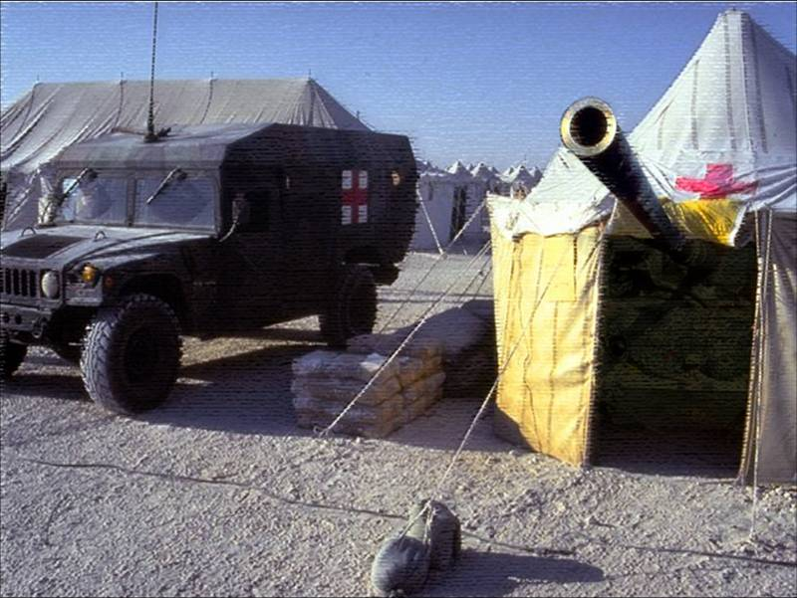
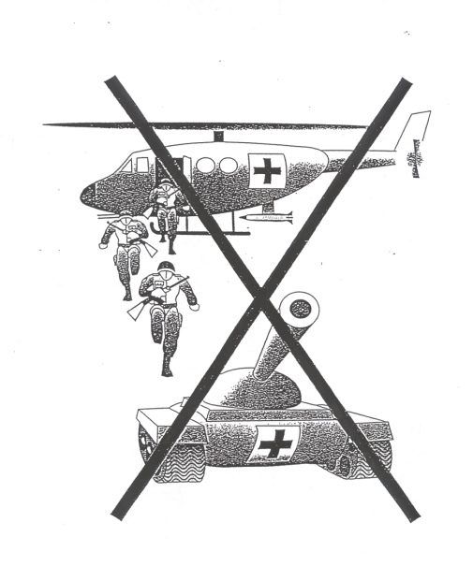
NO! NO! NO! NO!
These may seem funny if they weren’t so serious
Perfidy = deliberate deceit, i.e. using a protected emblem to gain a military advantage
Notes:
A weapon being fired from a marked medical installation – NO!
Armed troops stepping from a marked helicopter – NO!
Taking a deceitful and false advantage of the emblems of IHL is known as perfidy. Once the military does not know / cannot trust what is genuine humanitarian activity the entire system of protections offered by IHL falls apart.

Slide 8
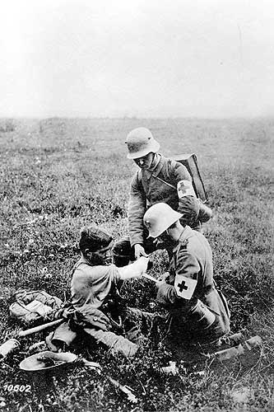
Exploration 1
Military Medical Personnel
and the Emblem
Notes:
8

Slide 9
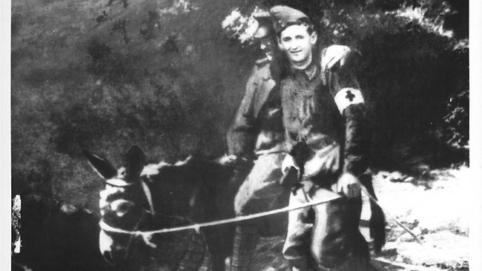
Simpson at Gallipoli
John Simpson Kirkpatrick 1892 - 1915

Slide 10
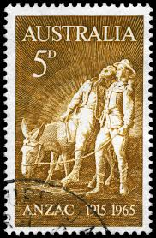
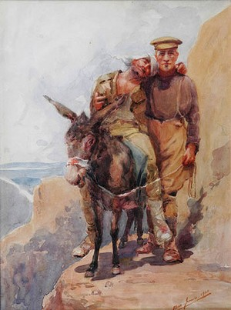
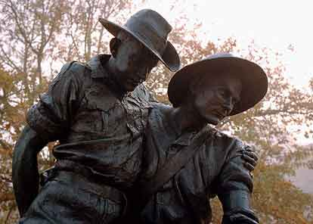
A legend’s status
Postage stamps, 1965
Immortalised in Peter Corlett’s sculpture, Australian War Memorial
Painting by Horace Moore-Jones, held in
Aigantighie Gallery, NZ

Slide 11
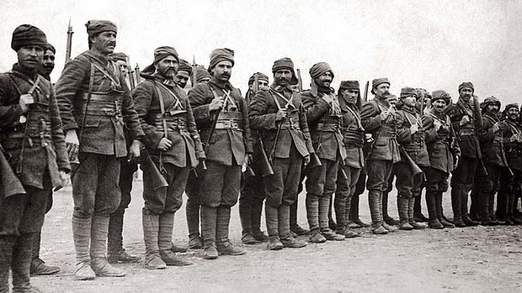
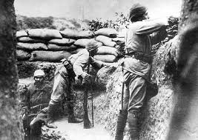
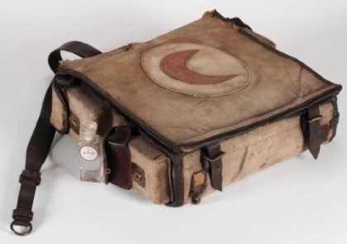
Turks at Gallipoli
Notes:
Turkish troops, trenches – and an Ottoman medical bag.

Slide 12
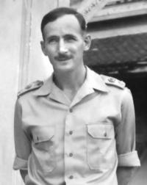
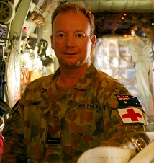
In Simpson’s footsteps
Weary Dunlop in 1945
FLTLT Brent Barker

Slide 13
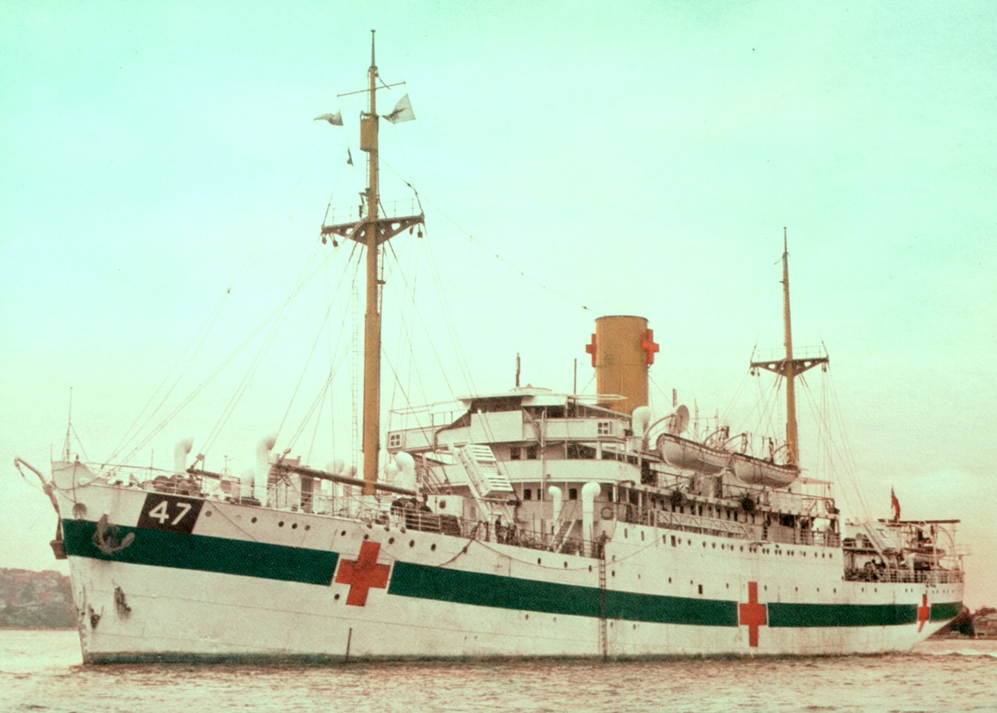
Exploration 2
AHS-47 Centaur
The Australian Hospital Ship Centaur, World War 2. photographer unknown. National Archives of Australia: NAA: B6416, 280, Public Domain, https://commons.wikimedia.org/w/index.php?curid=28088664
Notes:
13

Slide 14
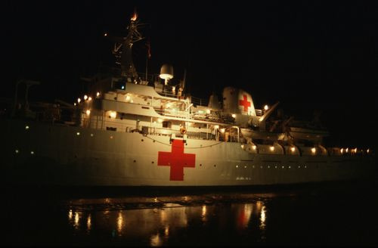
Hospital ships under the laws of war
Light up emblems at night for maximum visibility
Notify exact location to enemy forces
Ready to assist wounded from either side
HMS Hecla, at Montevideo,1982. ©ICRC/Luc Chessex
The operation of hospital ships was largely respected
during British/Argentinian conflict in Falkland Islands.
Notes:
A hospital ship does not hide its location. It transmits messages in clear (not code – as this would cause suspicion.) The International Red Cross is entitled to inspect the ship to ensure that no weapons or fighting troops are being transported.
When the protections of the Second Geneva Convention (for wounded and shipwrecked armed forces at sea, including hospital ships) do work, they may well do so because of mutual self-interest: in other words, it suits both sides.

Slide 15

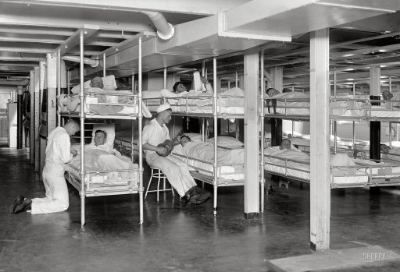
Hospital ships under the laws of war
Transmit in ‘clear’ – use of code would be suspicious
Internationally agreed signals to alert shipping/ submarines that this is a hospital ship
No arms to be carried
Notes:
Submarines, the new player of World War 1, brought new requirements for identification – eg radar and sound beams underneath shipping.
Image below left: Inside Ward G of the hospital ship Comfort, in June 1918, in New York harbour. Source: www.shorpy.com – Shorpy’s Photo Archive

Slide 16
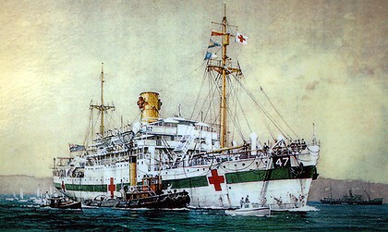
AHS - 47 Centaur
An artist’s impression of the Australian Hospital Ship Centaur, World War 2. Artist unknown. Source http://www.ssmaritime.com/centaur.htm
Notes:
See story in Starter Reading.

Slide 17
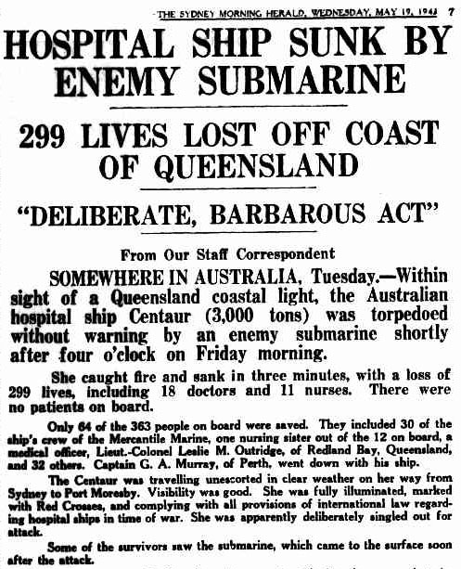
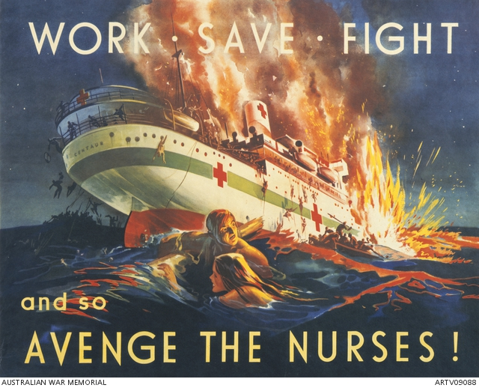
The news reaches the public
Notes:
The sinking became a rallying cry against a ‘barbarous’ enemy – ‘Avenge the Nurses’ – Source: Australian War Memorial ARTV09088

Slide 18
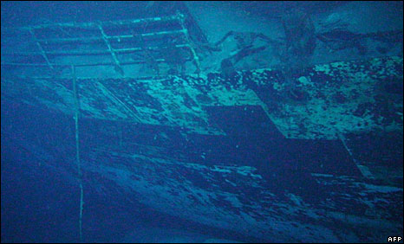
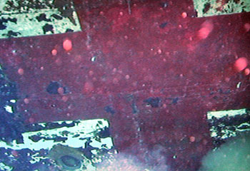
Found! 2059 metres below
Signage still clearly visible after 67 years
Notes:
Since the end of the war, many people have pushed to locate Centaur as a way of providing some solace to those family and friends who had lost loved ones, and to possibly answer some the unresolved questions surrounding its sinking.
A search led by David Mearns, who had previously lead the team that found the wrecks of HMAS Sydney and HSK Kormoran, discovered Centaur’s wreck on 20 December 2009. Centaur was located about 30 nautical miles off the southern tip of Moreton Island, off Queensland’s south-east coast.
The wreck was in one piece although it appears as though the hull broke in at least one, and maybe two, places. Centaur’s approximate position is 27˚ 16.98’S, 153˚ 59.22’E at a depth of over 2,000 metres. The ship’s location is less than 1 nautical mile (1.85 kilometres) from that calculated by the navigator, 2nd Mate Gordon Rippon, who was on the bridge taking regular bearings the night Centaur was torpedoed.
Now that the wreck is found, it will be protected by the Australian government’s Historic Shipwrecks Act 1976. The site will therefore be a memorial to the lives that were lost.

Slide 19

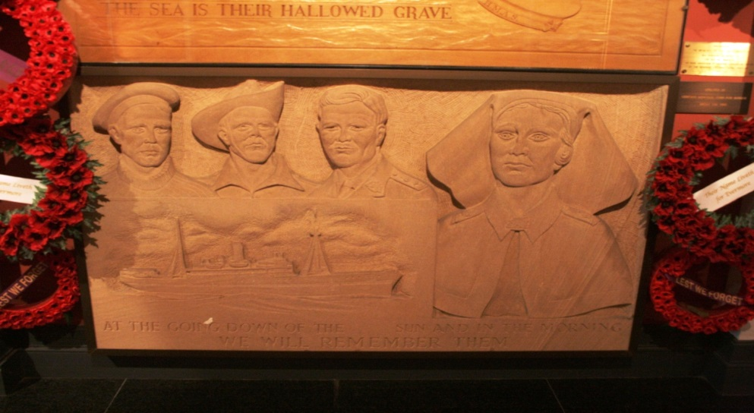
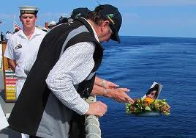
Memorials at sea, September 2010
300 relatives travelled across the Coral Sea on the HMAS Maroona to see the exact spot of the Centaur’s wreckage
Notes:
Red Cross played a part in memorials, and assisted family members, now elderly, to attend.

Slide 20
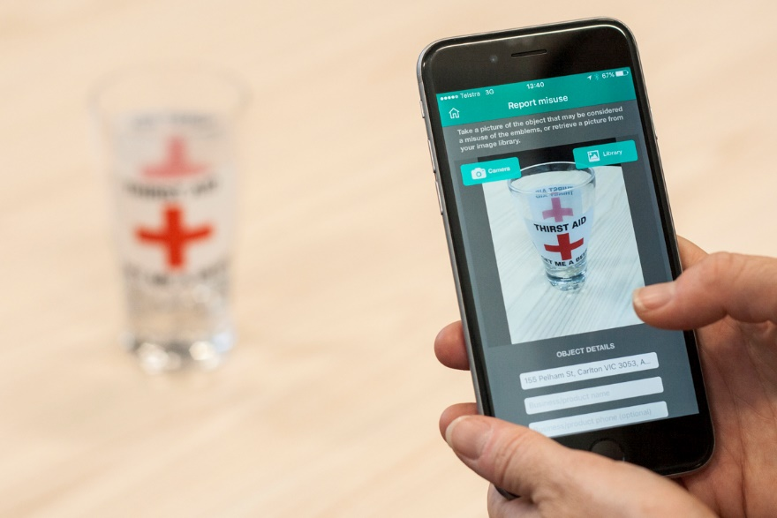
Exploration 3
Protecting the emblem today
Notes:
20

Slide 21



Have you seen the red cross used incorrectly?
Medical centres, hospitals, pharmacies, vets and gyms
First aid kits
Toys
‘helping/repairing’ or health products

Slide 22



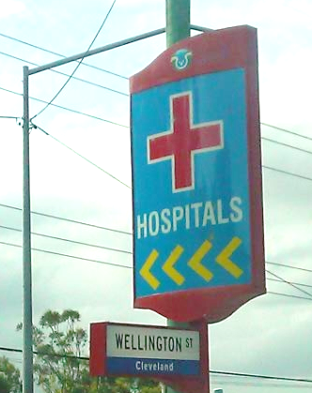
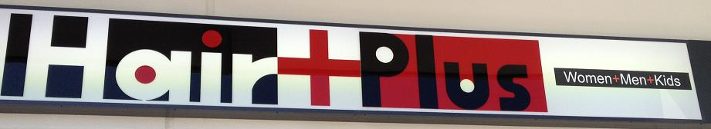

What about these?
Notes:
Optional slide (for the legally minded only?)
Extract from the Geneva Conventions Act 1957 (Commonwealth)
Section 15
Subject to this section, a person shall not, without the consent in writing of the Minister or of a person authorised in writing by the Minister to give consents under this section, use for any purpose whatsoever….the red cross, red crescent…..
Section (e): a design or wording so nearly resembling any of the emblems or designations specified in the preceding paragraphs of this sub-section as to be capable of being mistaken for, or, as the case may be, understood as referring to, one of those emblems.
Discuss the test ‘as to be capable of being mistaken for’ and decide which of these students think meet the criteria

Slide 23




In peacetime, does it matter?
Commonwealth law
Minister of Defence
Australian Red Cross
  Runs pro-active campaigns
  Makes friendly contact by letter or phone
  Sends quarterly reports to the Minister

Slide 24

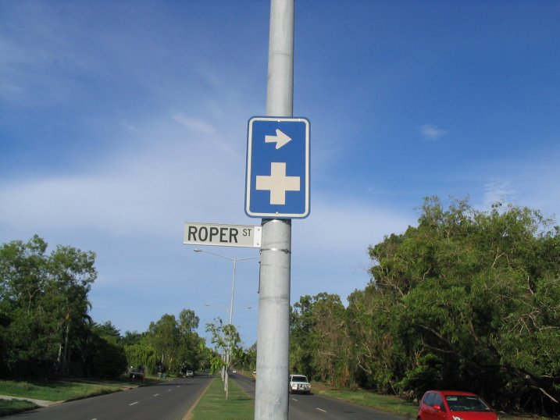
Correct emblems
White cross on green for First Aid
Occupational Health and Safety (eg on building sites)
Road signs for Hospital
Blue capital H is also used

Slide 25
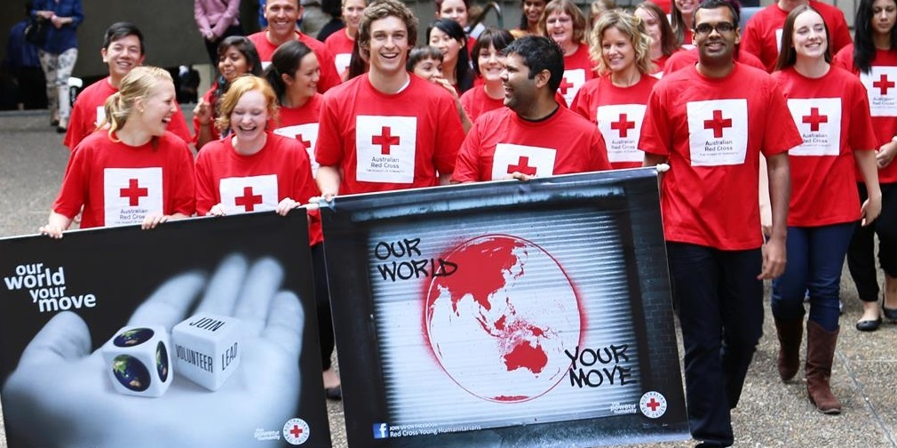
Take-home messages
The red cross emblem is unique: it offers protection during war.
Those in areas of armed conflict overseas know this: they see it save lives every day.
All Australians should understand & respect it.
Report misuse of the emblem:
  Mobile app: https://www.redcross.org.au/about-us/the-emblem/the-emblem-app
  Send an email to: emblemmisuse@redcross.org.au

